Slide 1
MyKOKO - Referral Program
Design - Version 1

Slide 2
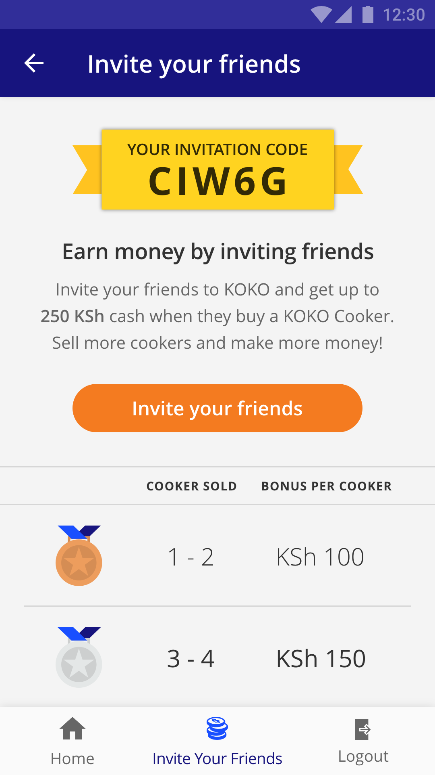
Invite your friends
It all starts from here.

Slide 3
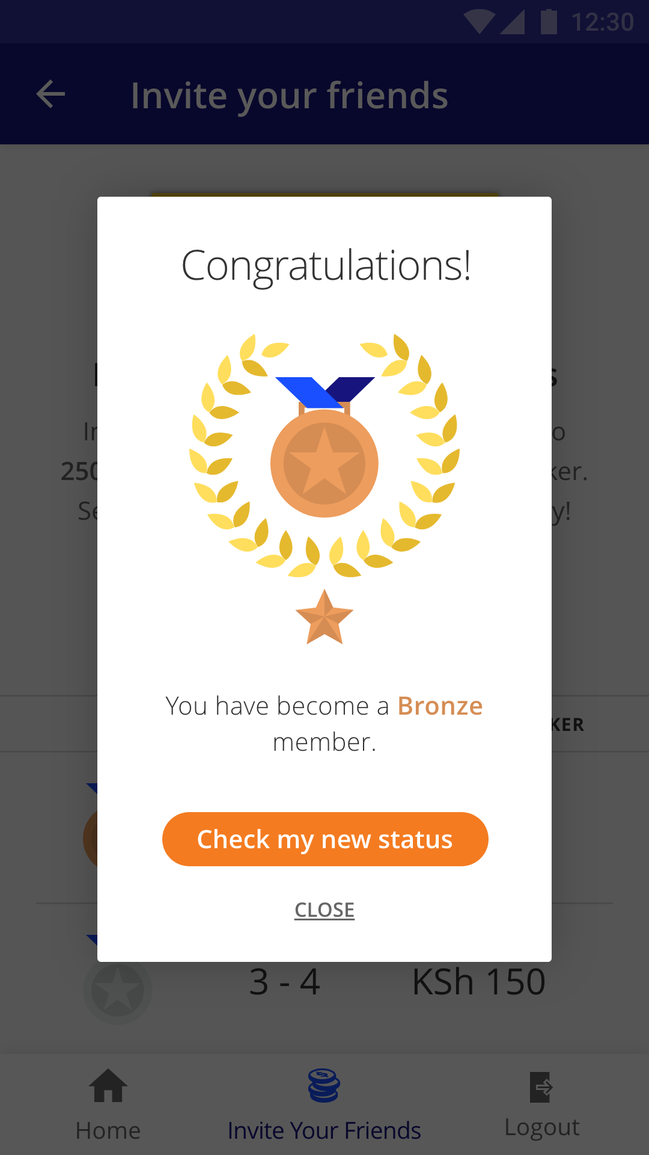
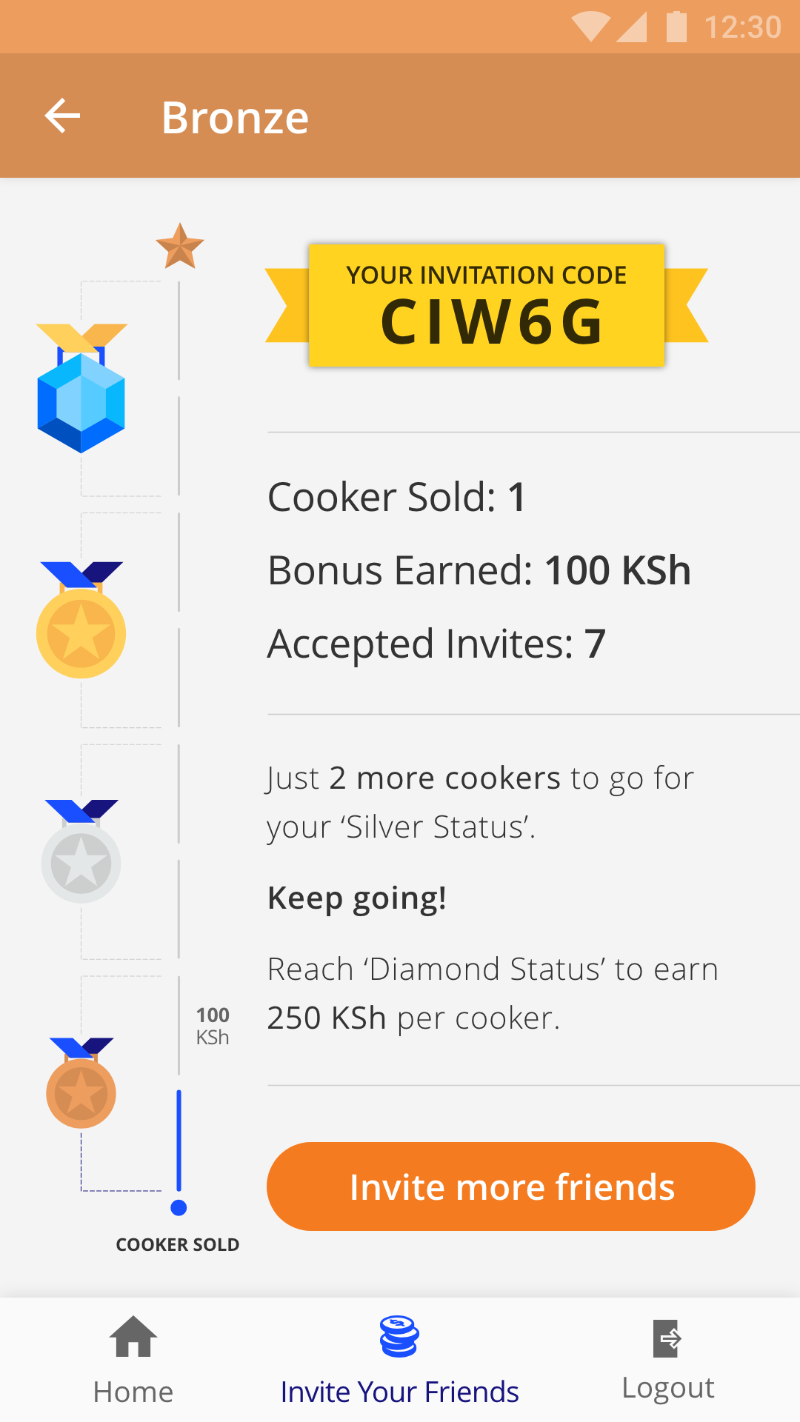
Bronze Status
Once one of the referral buys a cooker. He/she happens to be the users first at that point. The referrer gets a notification in form of a dialogue box informing about it and invites them to check the new status page (this is essentially the ‘Invite your friends’ screen changing the theme to ‘Bronze’ (the first objective in the referral program).

Slide 4
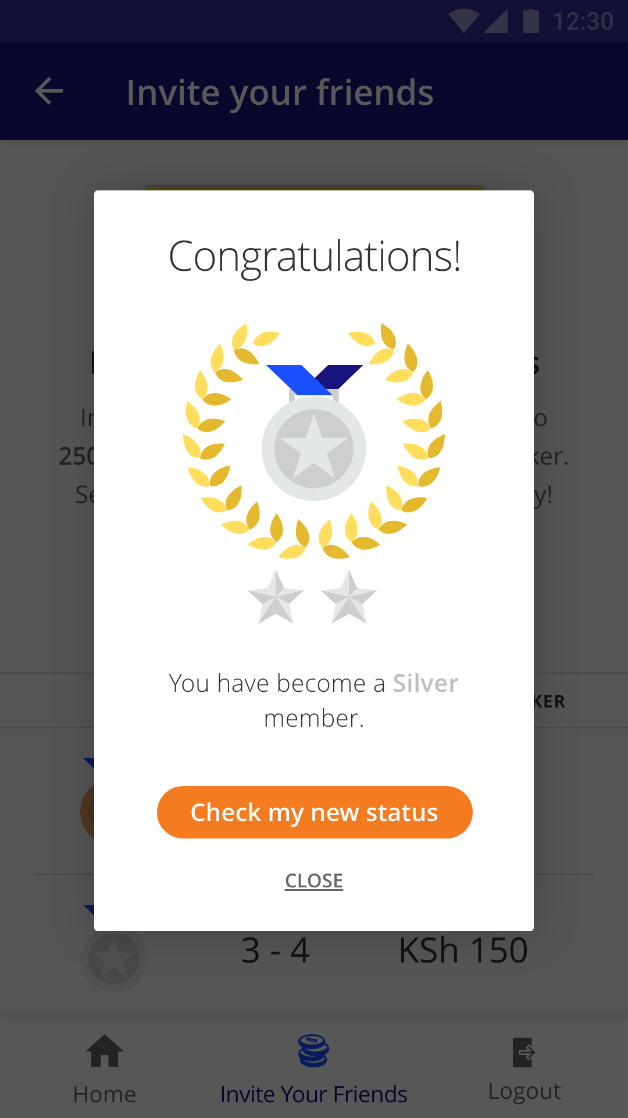
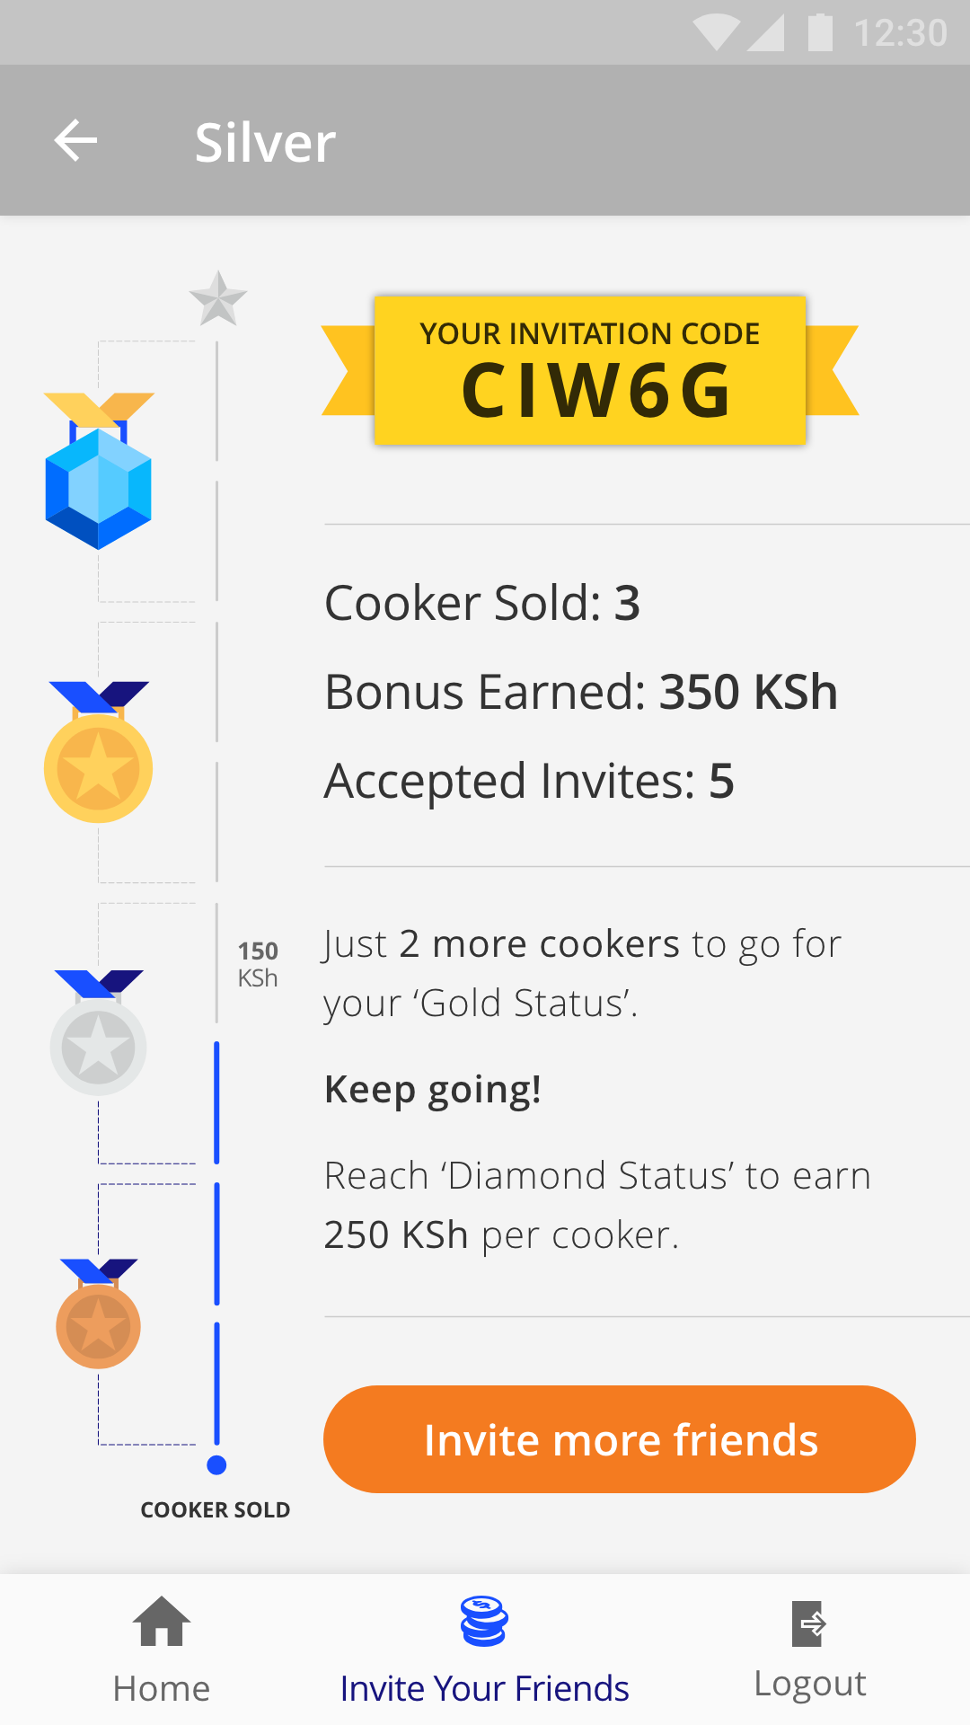
Silver Status
This will appear when the user manages to sell the 3rd cooker.

Slide 5
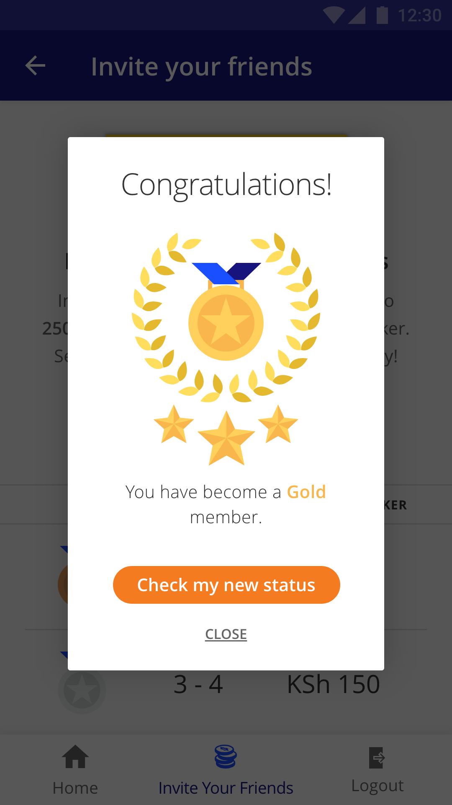
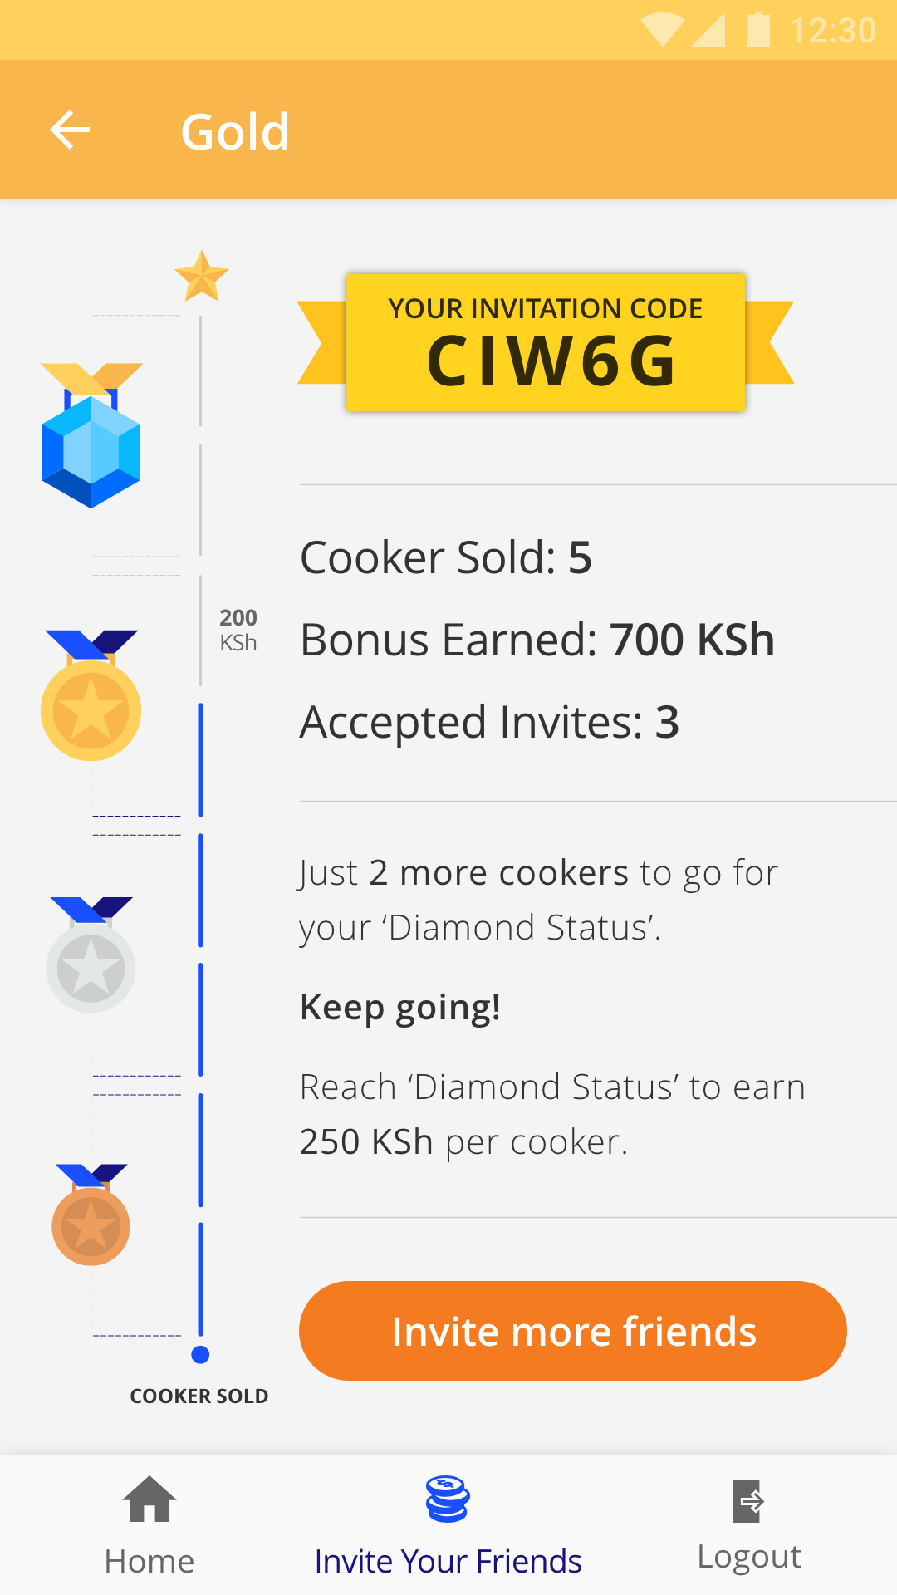
Gold Status
This is achieved when the users sells the 5th cooker.

Slide 6
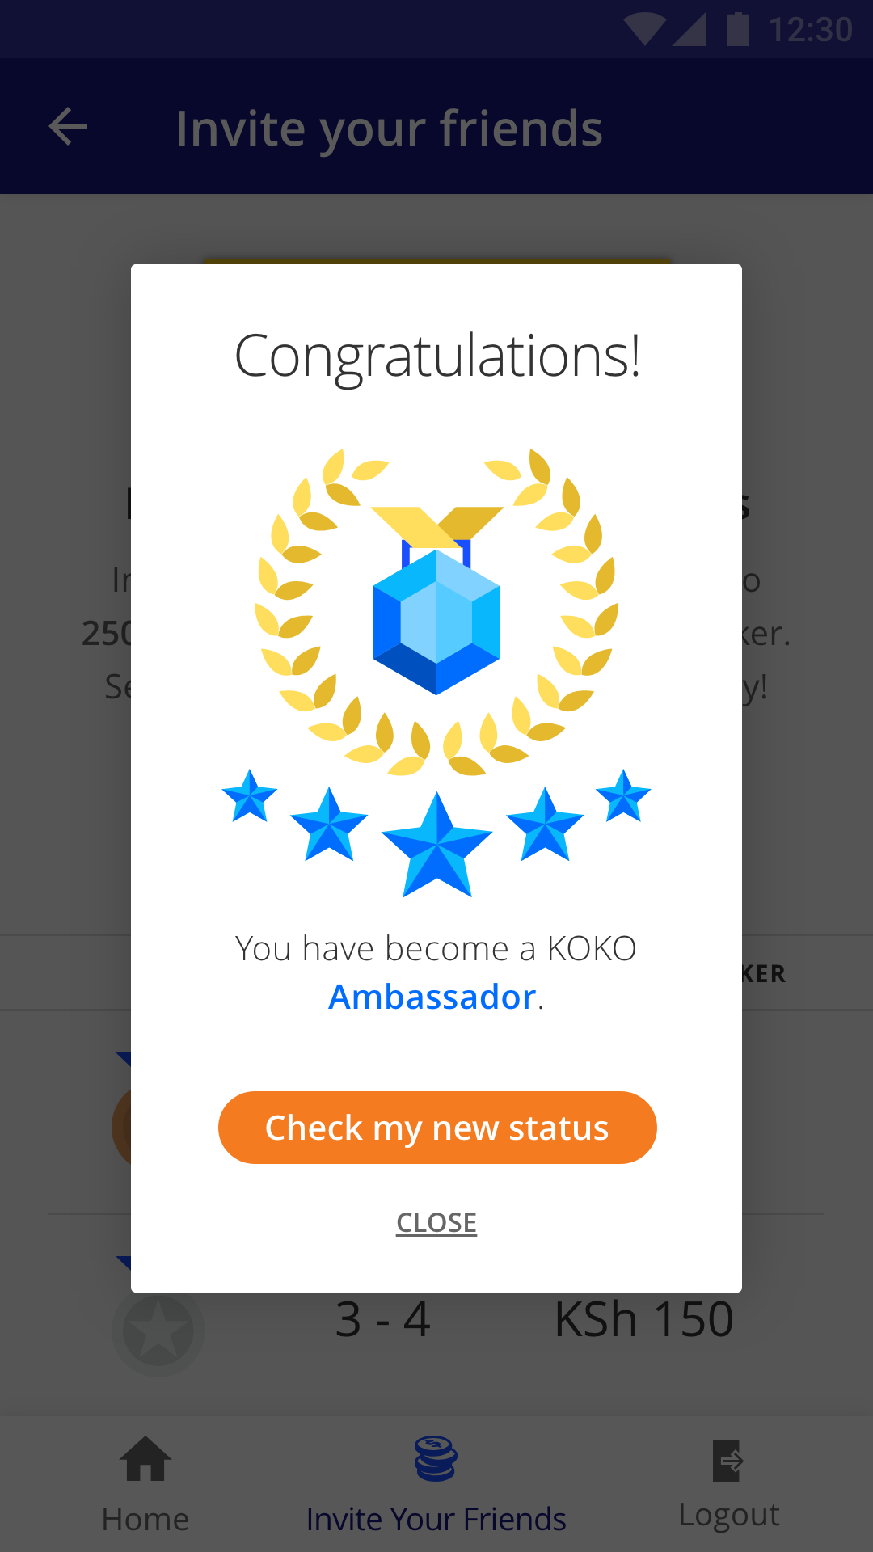
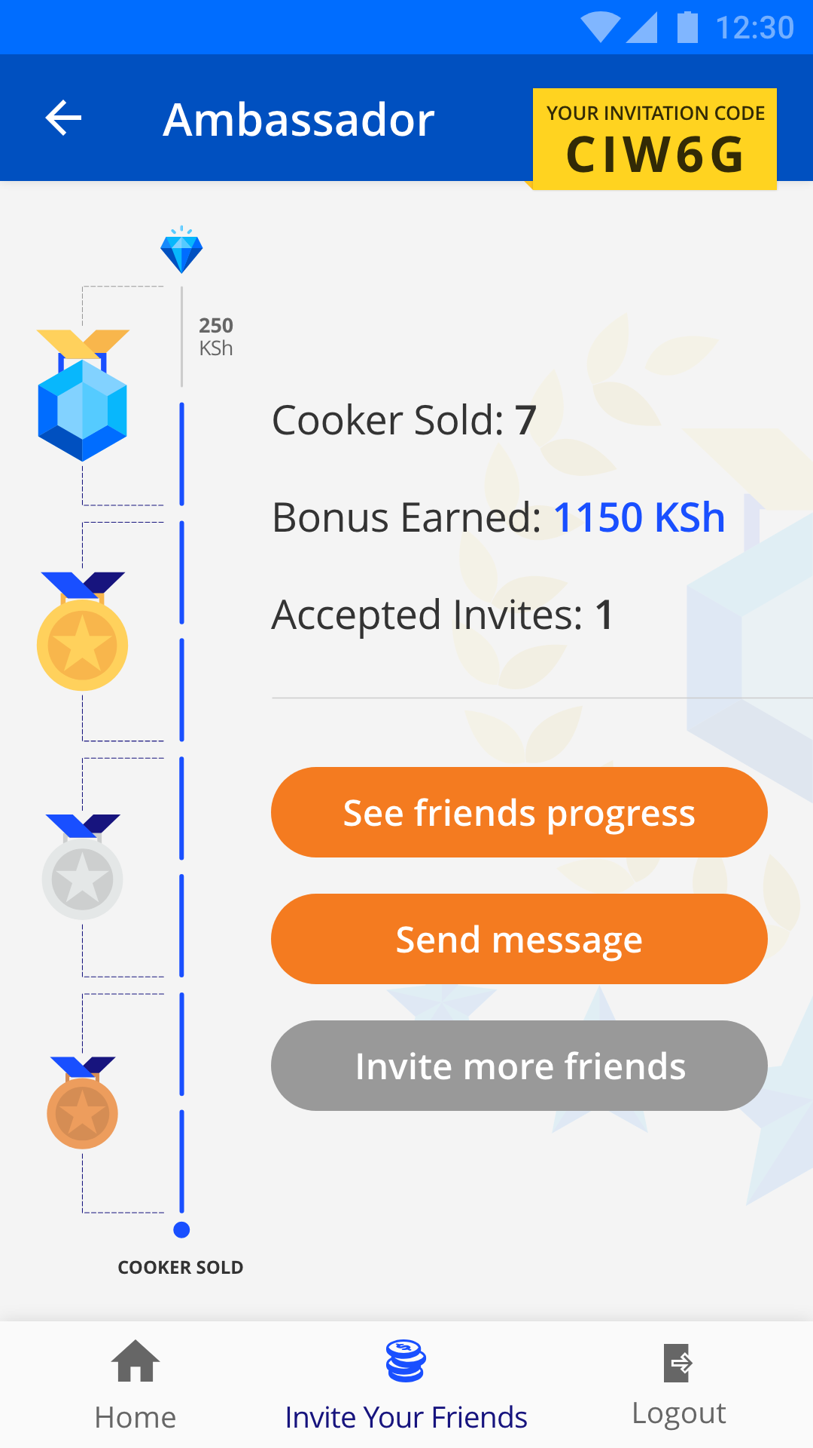
Ambassador
This is the final level of the referral program. From here users will continue getting max bonus of 250 KSh per cooker sold. Also this level unlocks the 2 new features. However, users can still continue adding more friends.
Feature 1. Checking progress of the referrals is possible (the user can also send personal message for high conversion rate).
Feature 2. The user can send messages to a group of friends at once. These messages can also be scheduled for future date & time.

Slide 7
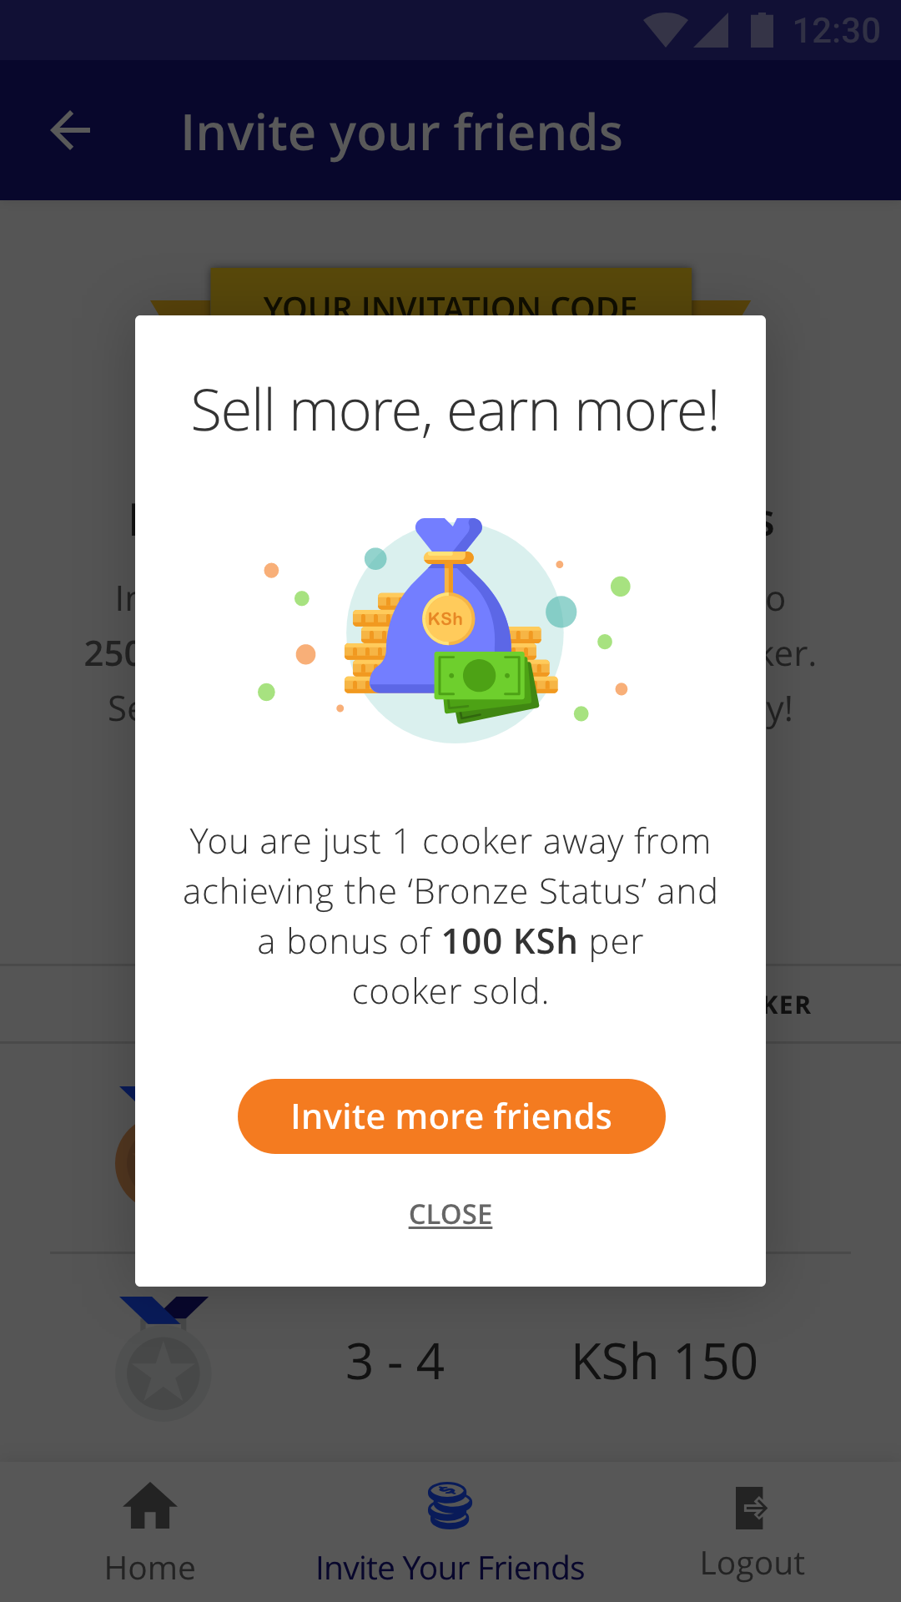
Periodic words of encouragement
The users would be send regularly these notification and would be encouraged to push to achieve the highest level.

Slide 8
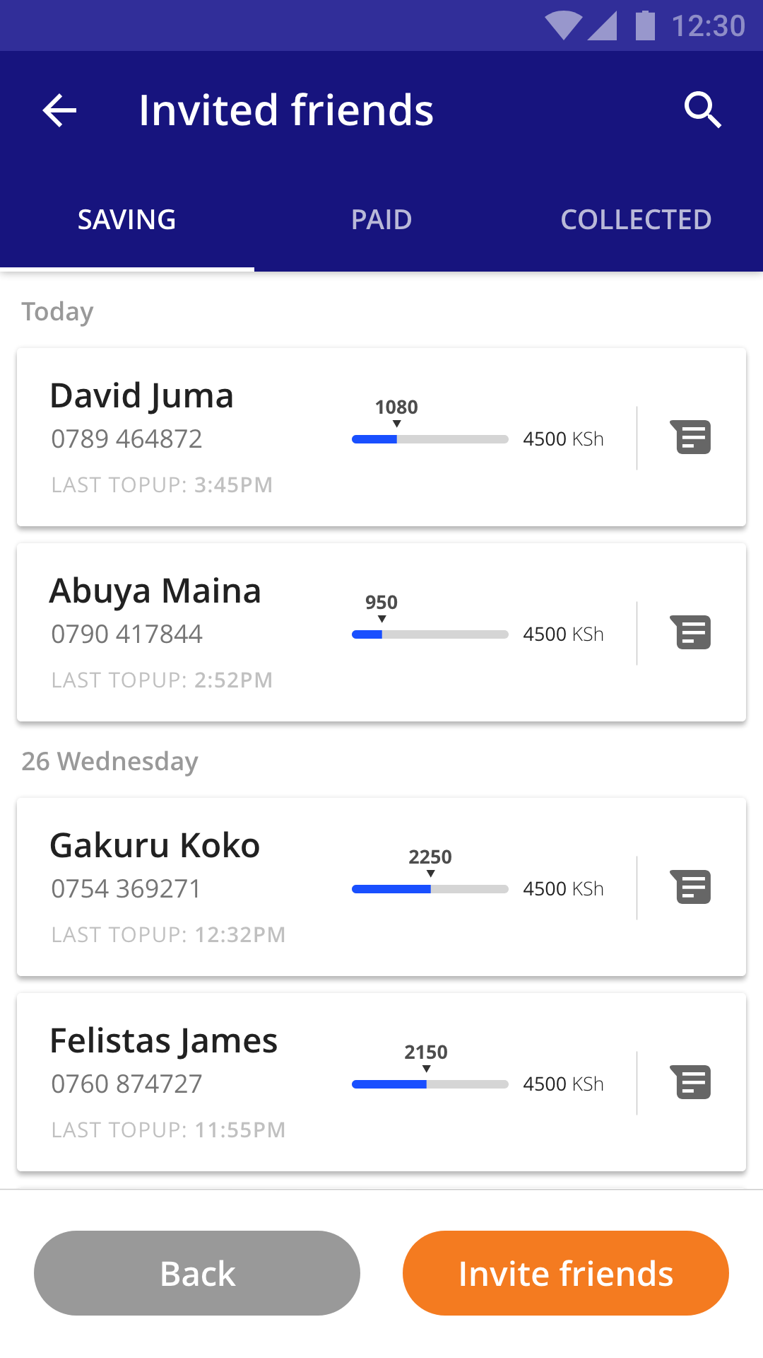
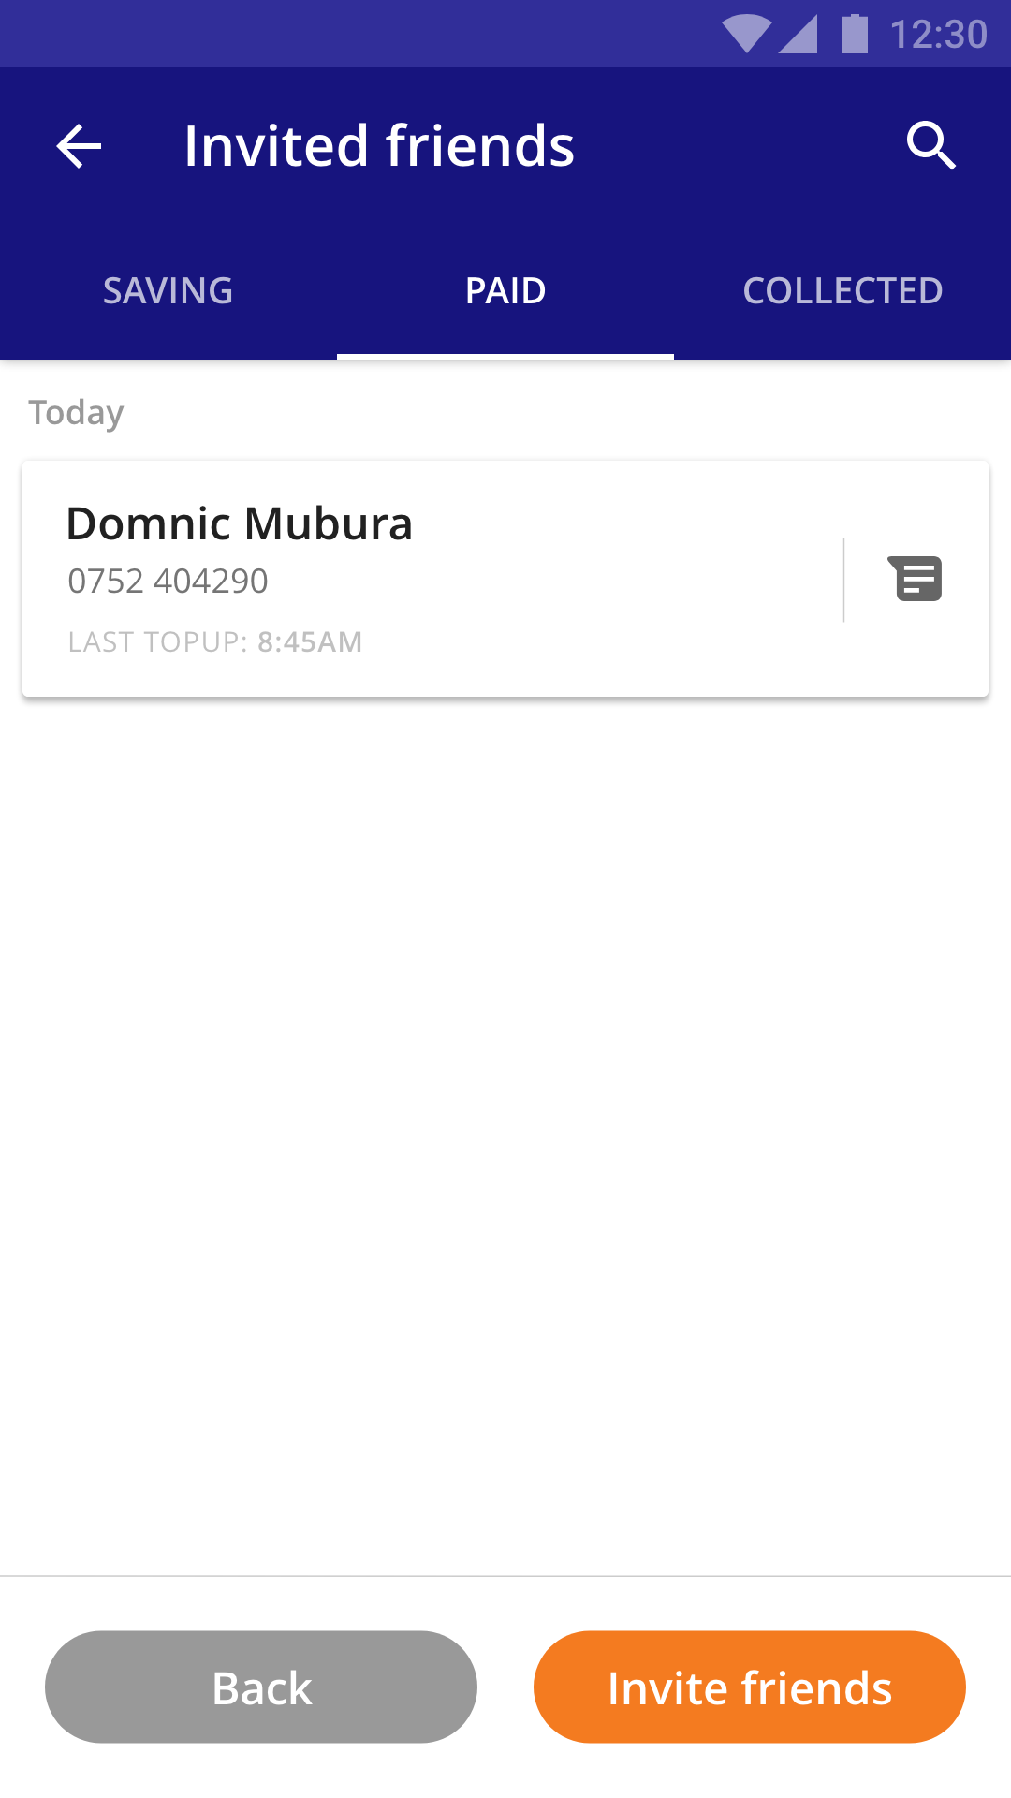
Checking progress of the referrals
Here the user can check on the progress made by the invited friends. These are further segregated into 3 categories ‘Saving’, ‘Paid’ and ‘Collected’.
The table updates dynamically by showing the latest top-ups first on that particular day addinationaly they are shown as per previous dates as well (based on the latest activity that happened on that date) for eg.: if ‘Gakuru’ tops up today, then that friends will appear at the top and will be removed from ‘26 Wednesday’. As that friend has topped up recently.

Slide 9
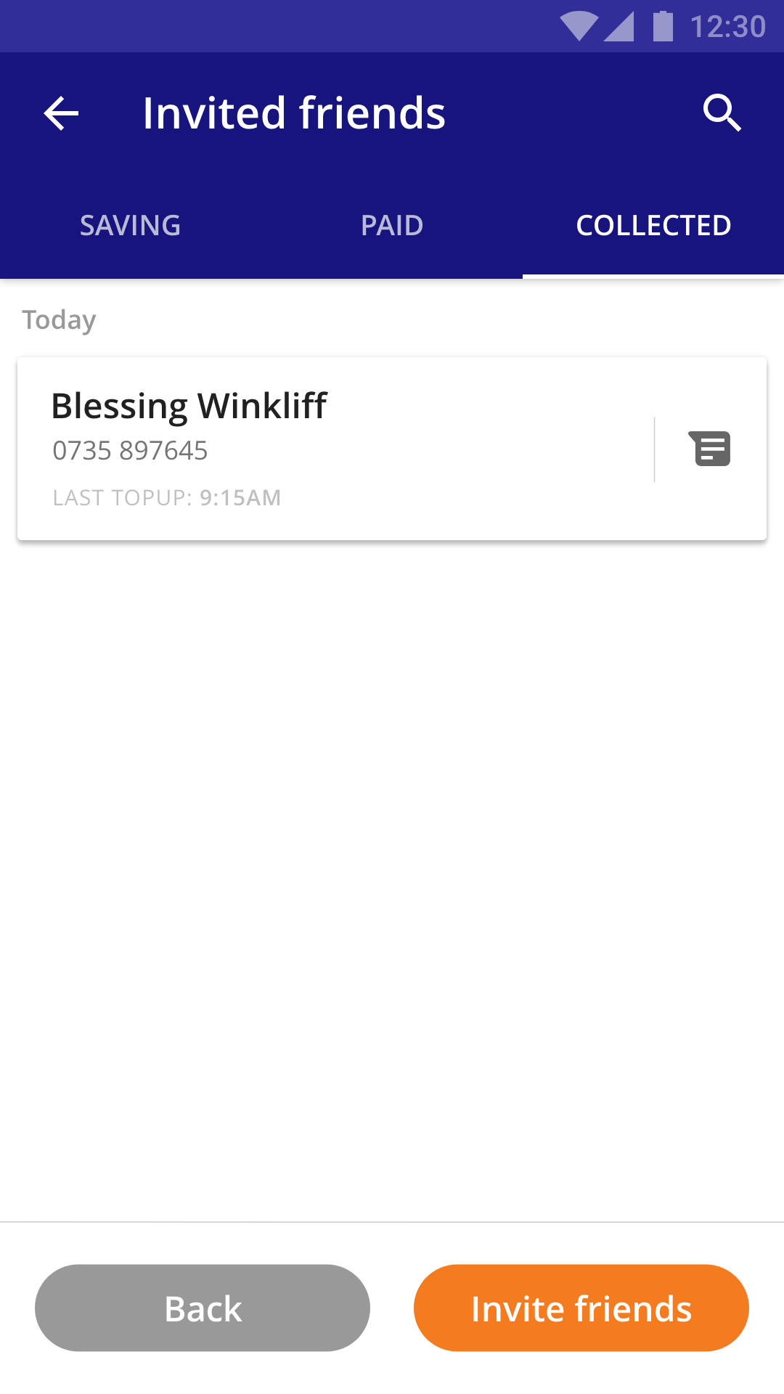
Screen 3 from the previous journey

Slide 10
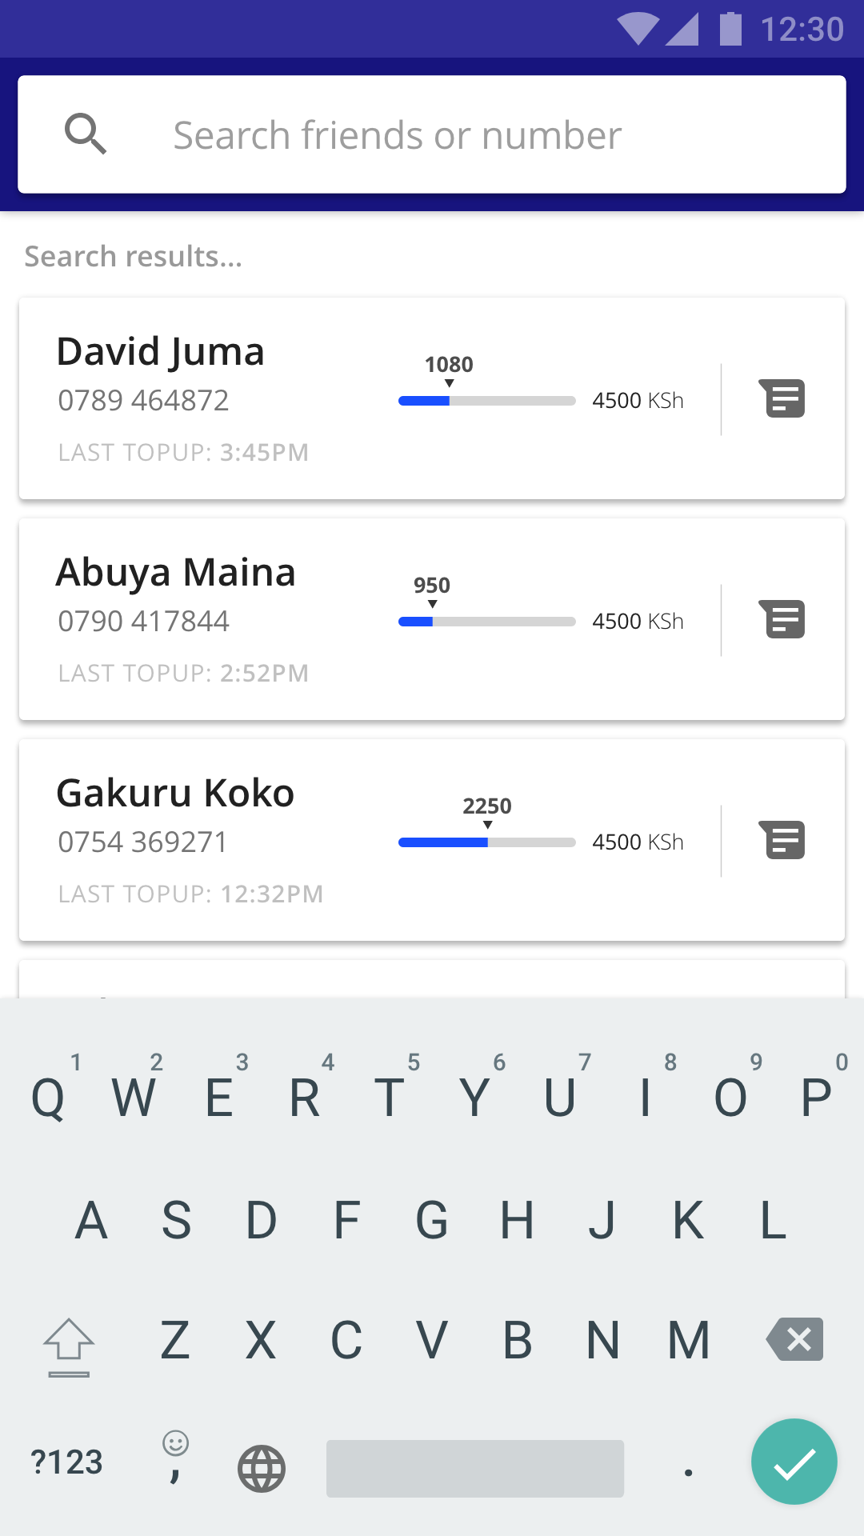
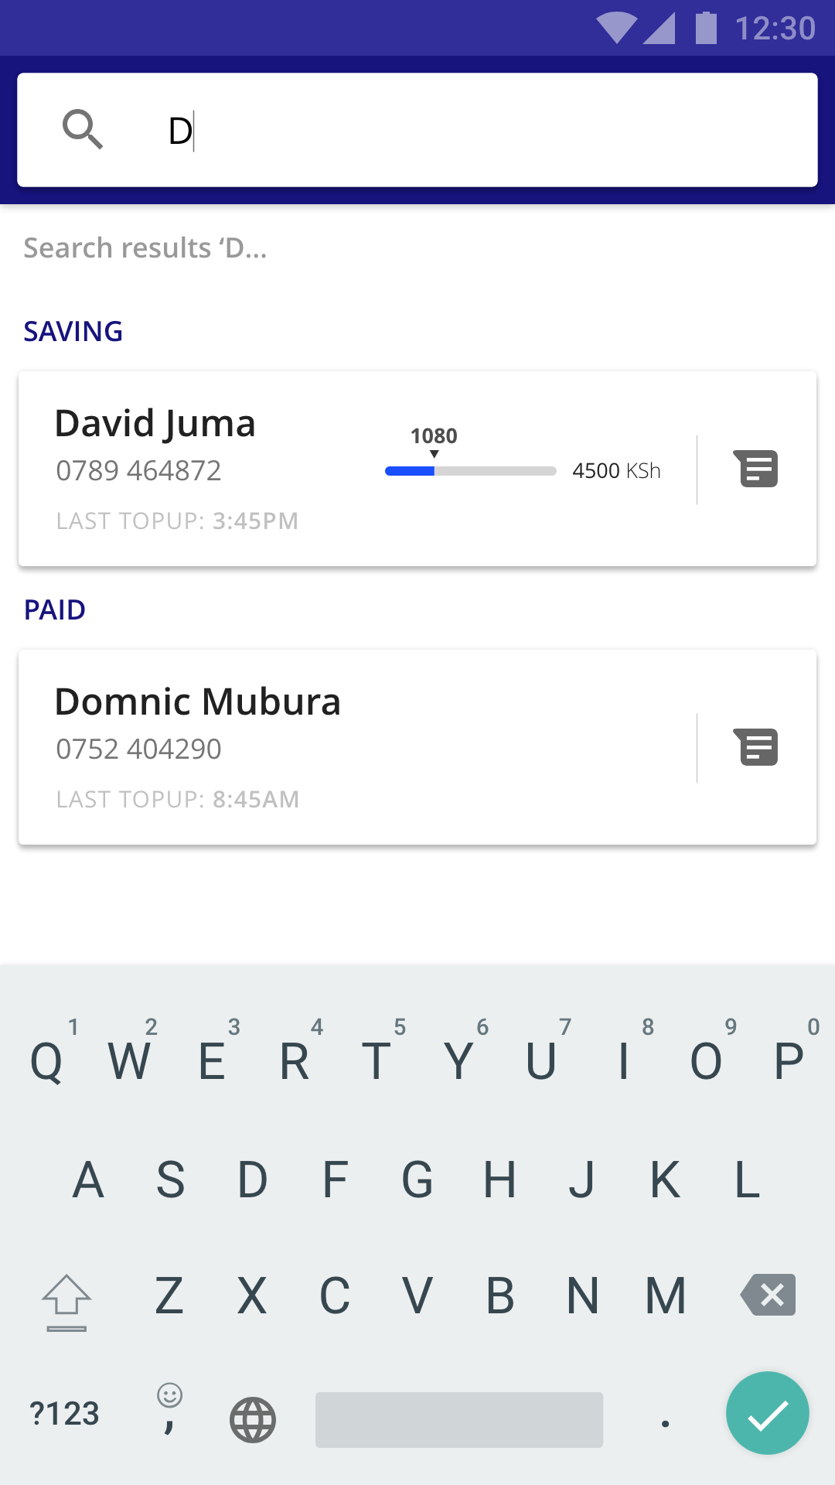
Dynamic search
The search functionality is dynamic. As soon as the user starts typing the name or number the entire list of friends will start filtering and will show the relevant result. This particularly beneficial when the user doesn't have time to type the whole name and at the top of his/her mind knows who they are searching for to check on progress and send a encouraging personal message.

Slide 11
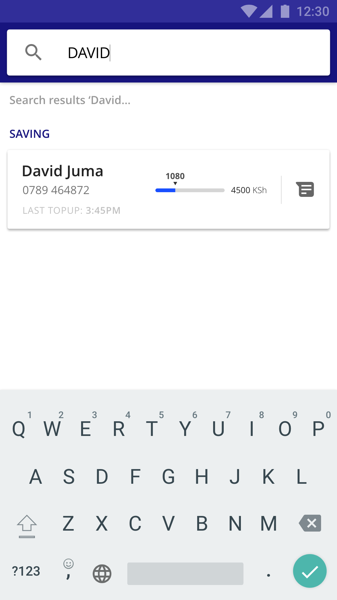
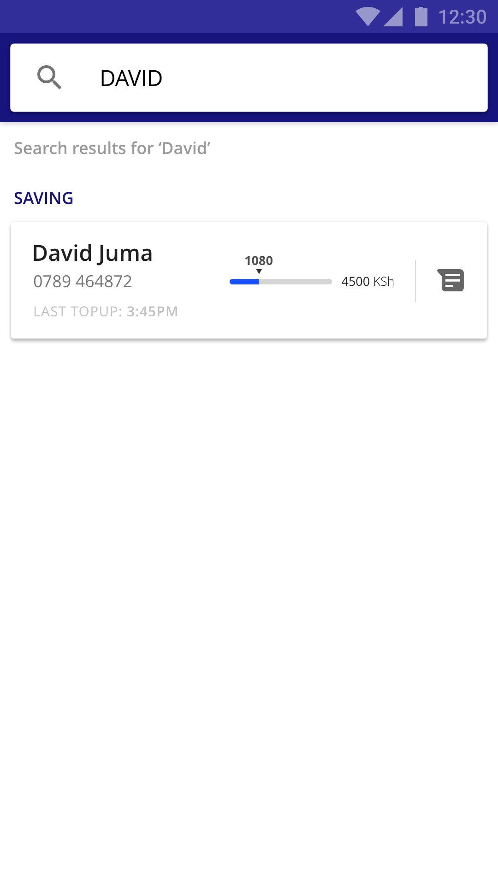
Screen 3 and 4 from the previous journey

Slide 12
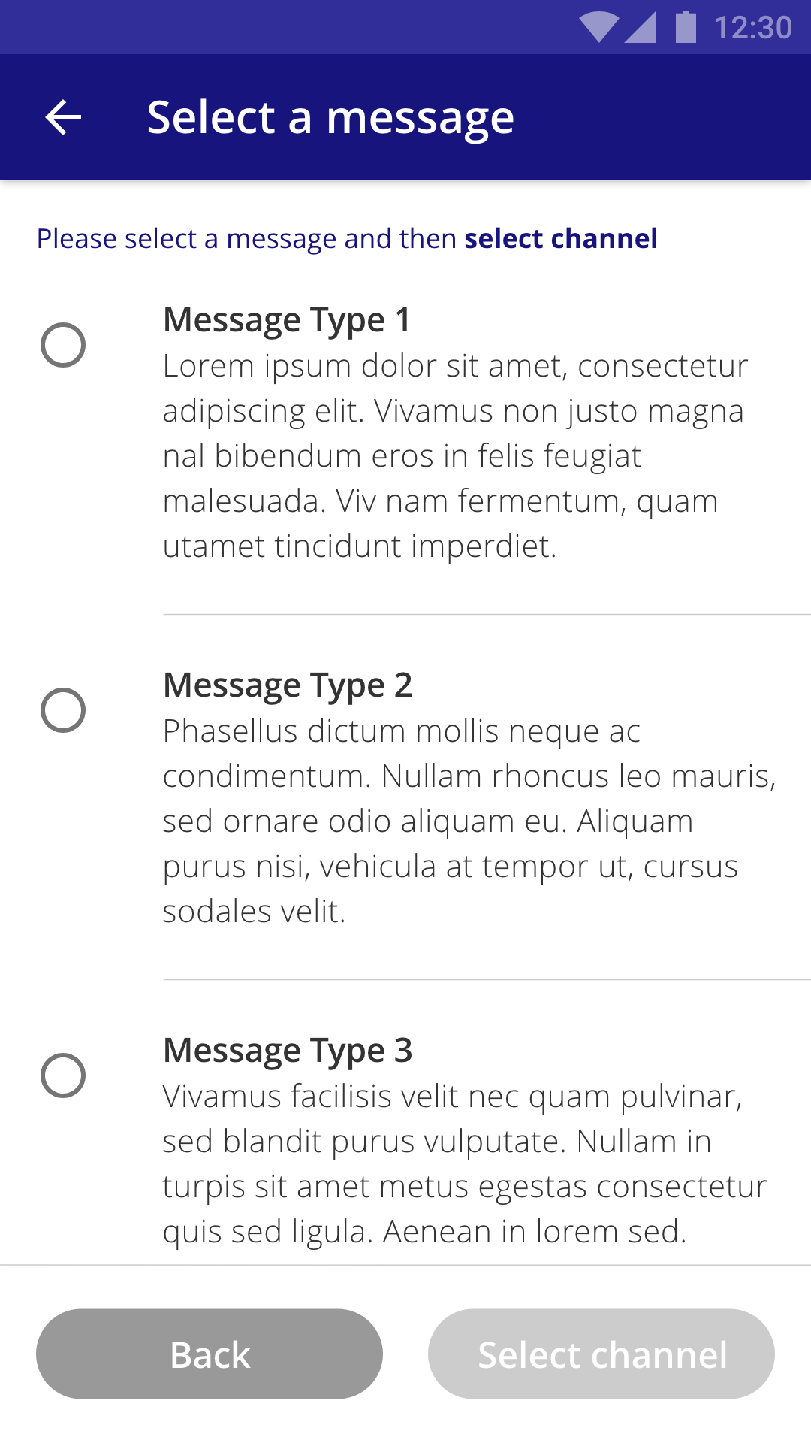
Sending a personal message to ‘DAVID’
On successfully searching the required friend. User now wants to send a personal message to David. The user here simply taps on the message icon that will take him/her to the ‘Select a message’ screen. From here a relevant message would be selected from the list of messages provided to the user.
Note: Following slides will have 3 more screens that are part of this journey...

Slide 13
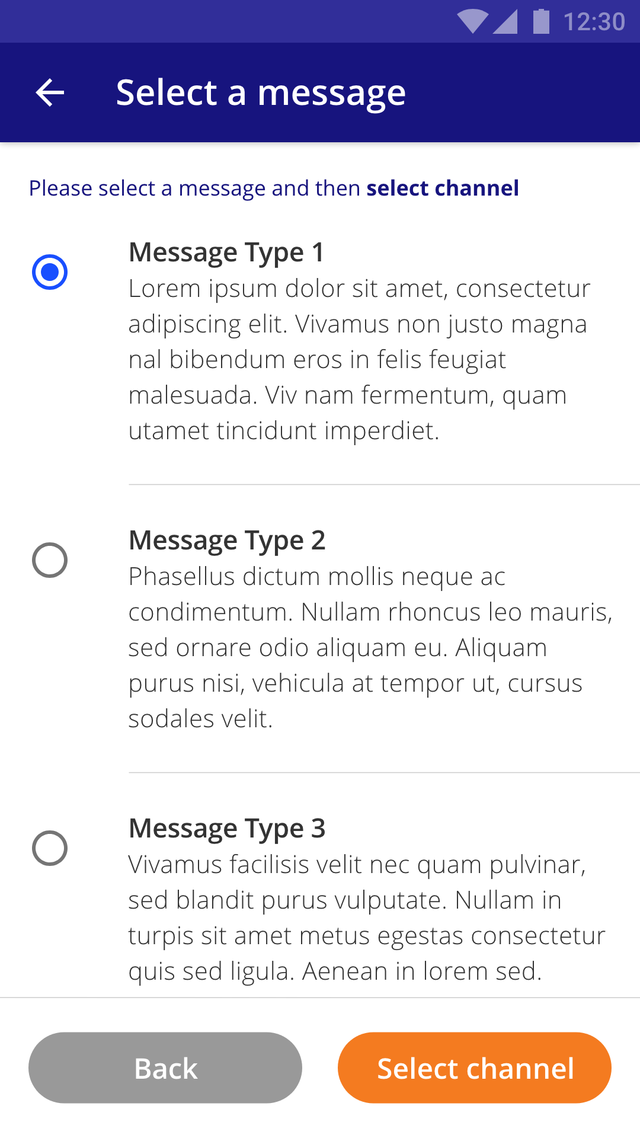
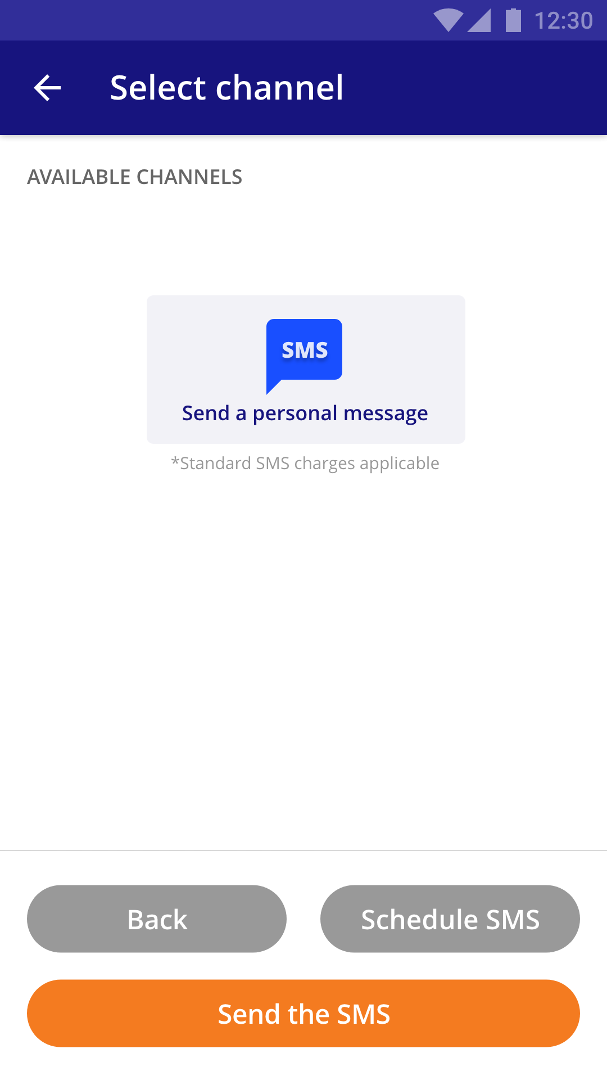
Sending a personal message to ‘DAVID’
...With the message selected the user would proceed to select the channel. In this case, however since the friend has already been selected the only option available is ‘SMS’. The user here simply has to either ‘Schedule SMS’ if he/she wishes to or can simply ‘Send the SMS’.

Slide 14
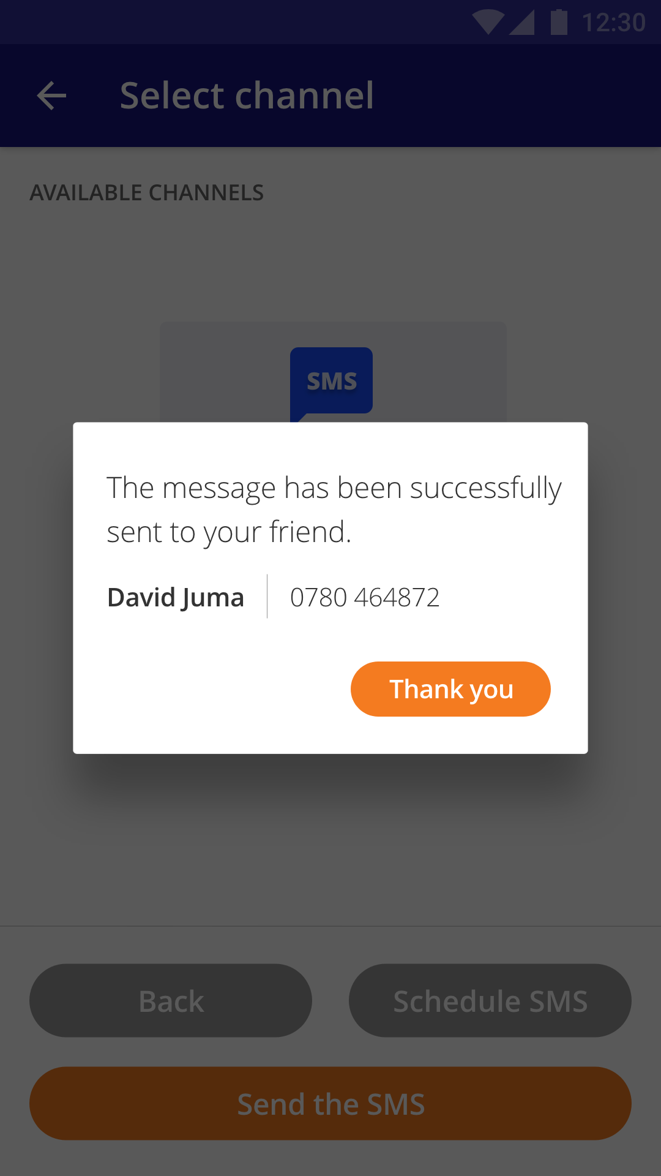
Screen 5 from the previous journey.
This essentially is a success message. The idea is to only inform the user that the message was sent. Success depends on the network. But we inform the user regardless.
Tapping on ‘Thank you’ will take the user back to the ‘Ambassador’ screen to perform any other tasks.

Slide 15
Sending message to a group of friends
From the ‘Ambassador’ screen when the user taps on the ‘Send message’ button the user will come to ‘Select a message’ screen. However, the only difference here is when the user taps on ‘Select channel’ there will be additional channels made available to him/her, covering that in the next slide...

Slide 16
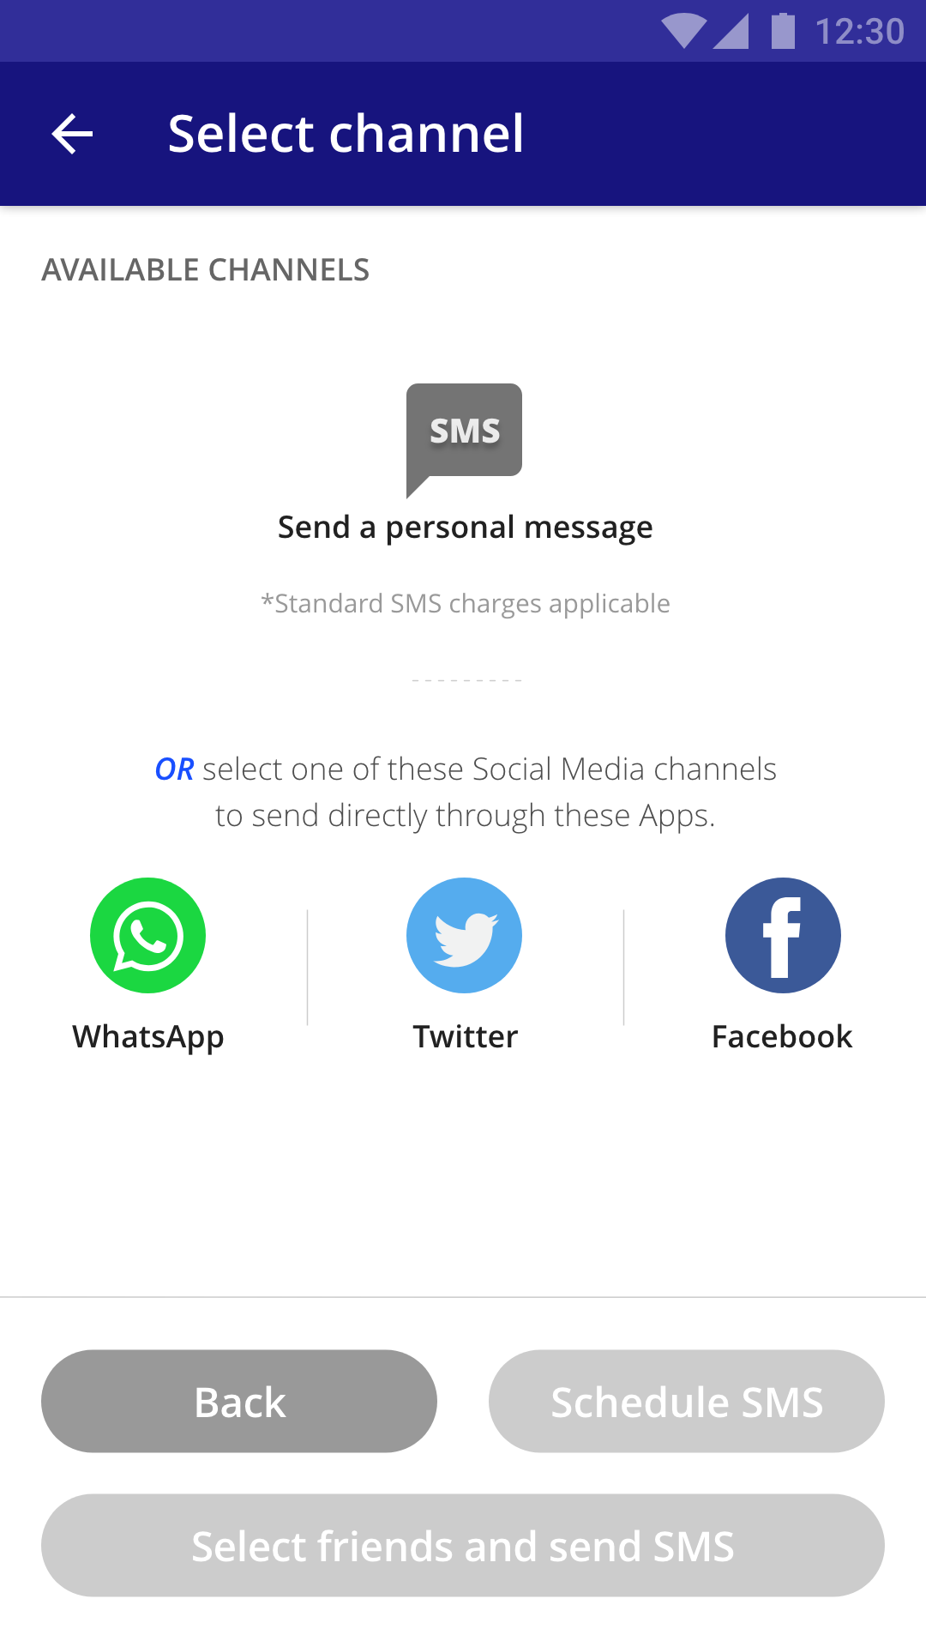
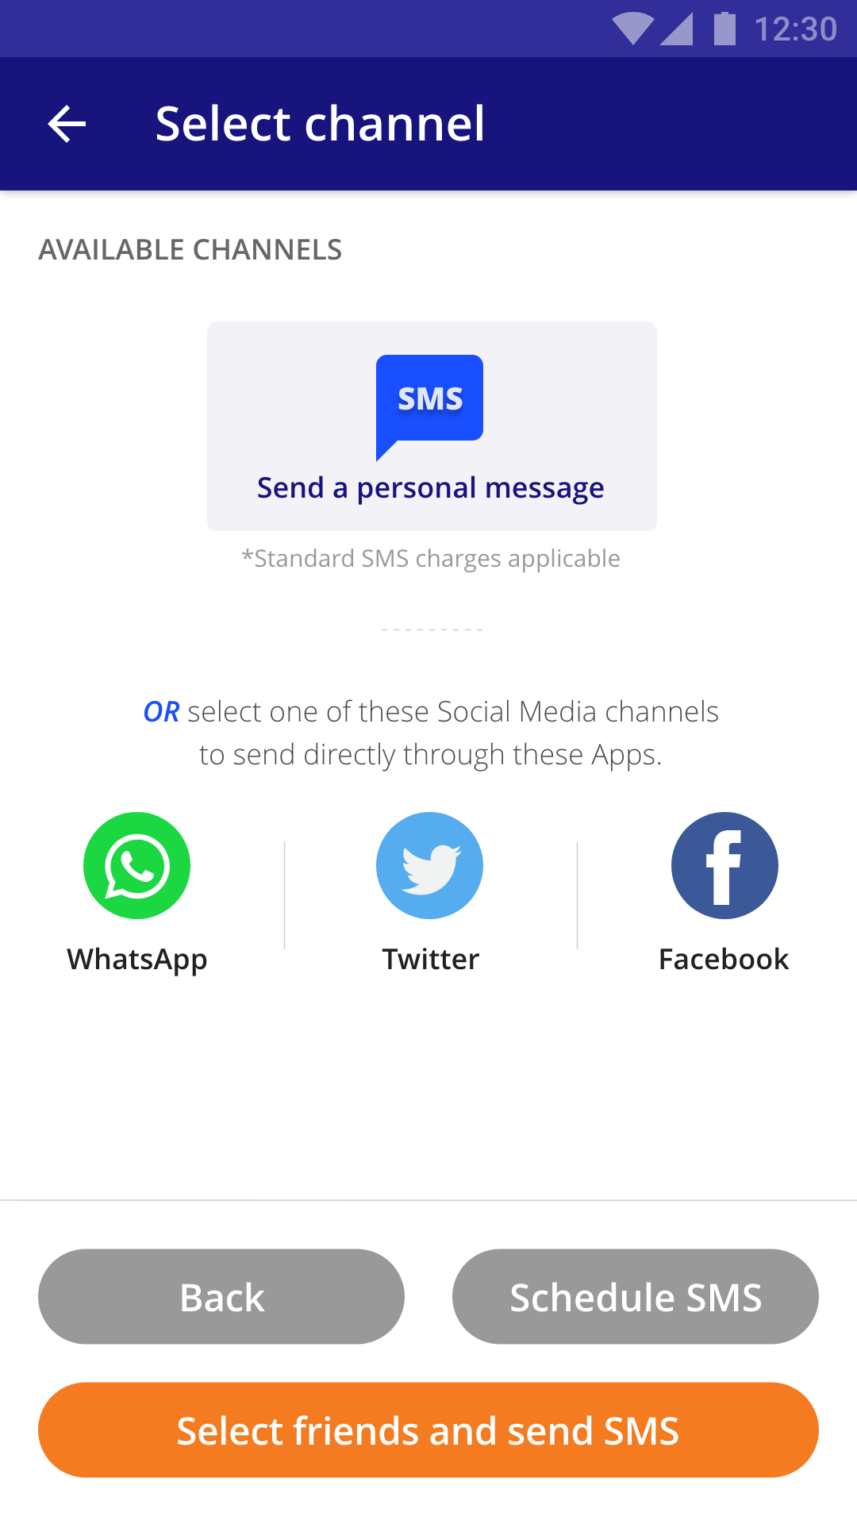
Sending message to a group of friends
The user here can select social media as a medium to send his/her message. But that would take to user to App interface of the selected social media channel.
If the user chooses to send a personal message then he/she has option to schedule it and then proceed to select friends (referrals only list) or simply send the message directly.

Slide 17
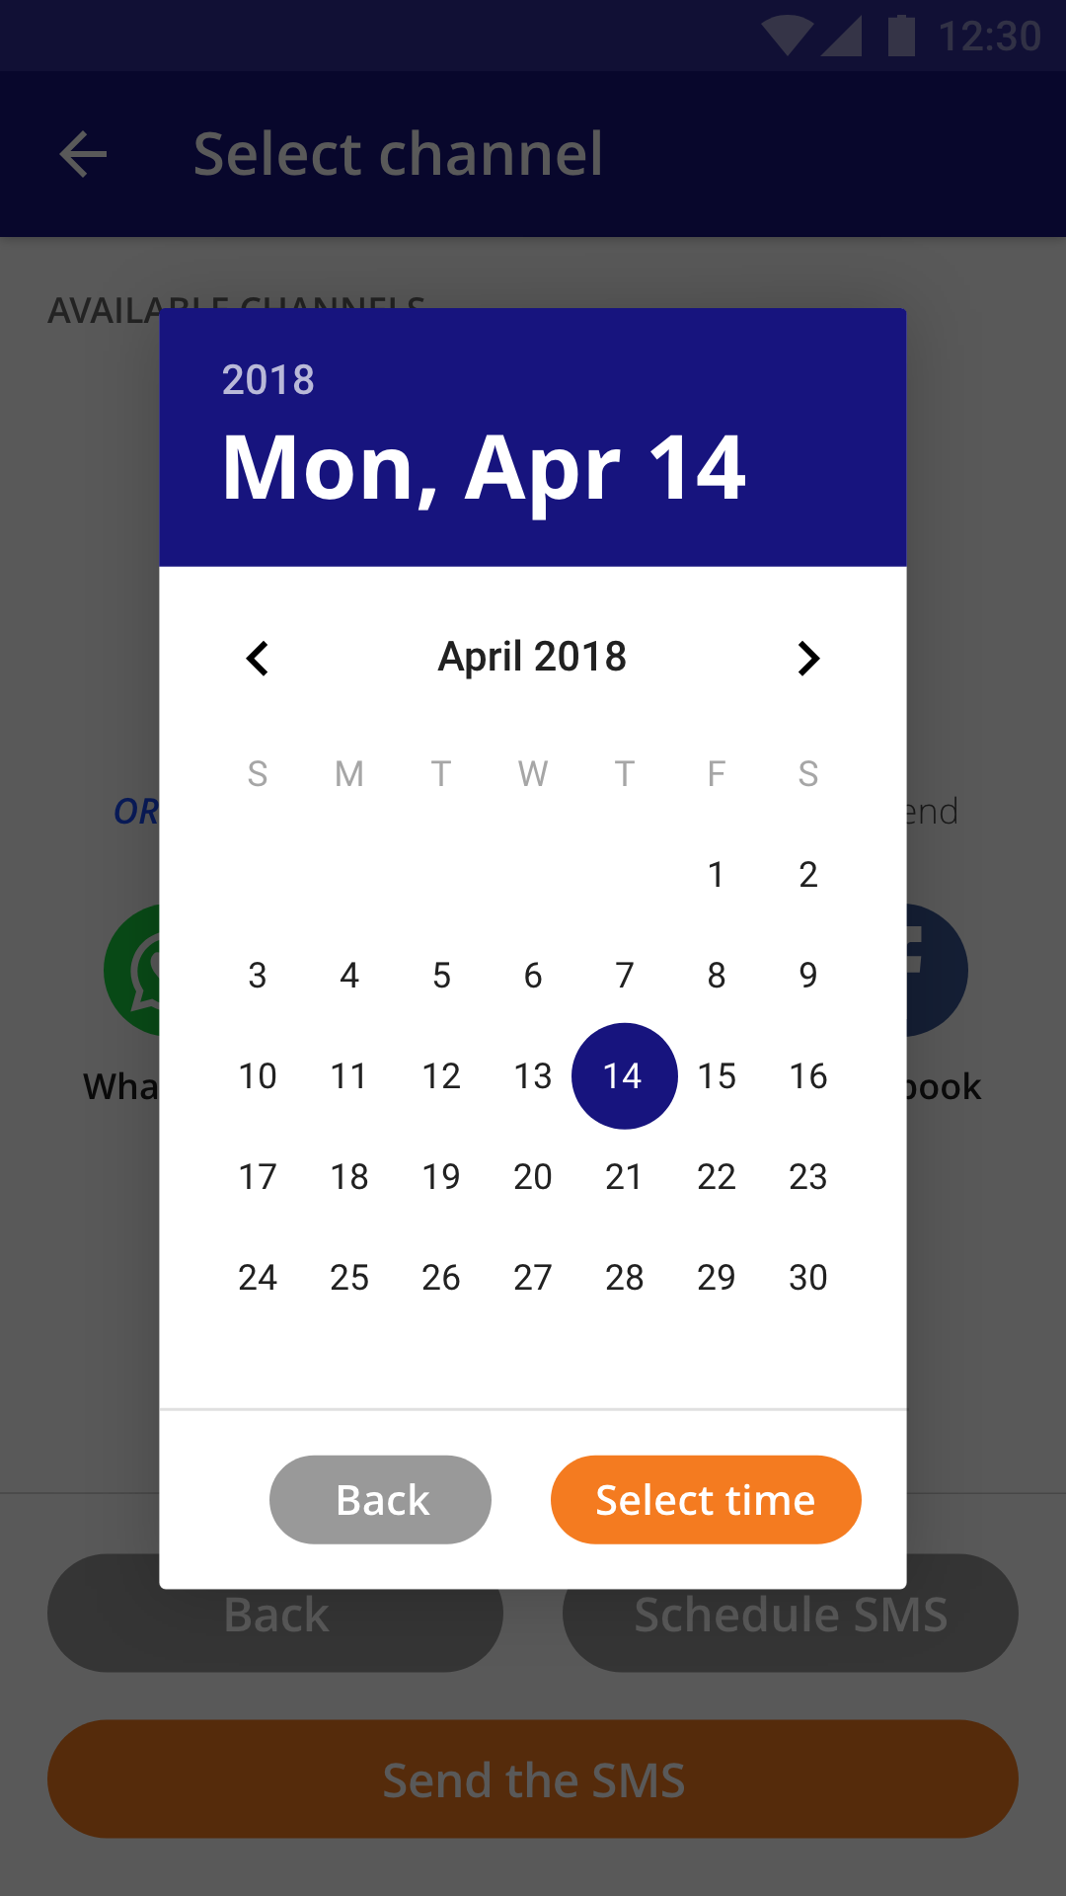
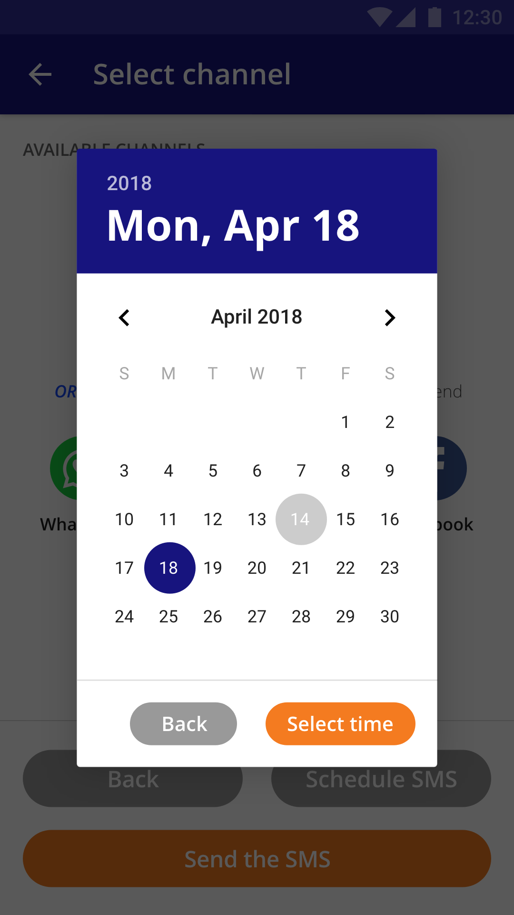
Scheduling SMS
Selecting the Date
By default the current date will be selected which the user can change if he/she wishes to. These screens represent that selection.

Slide 18
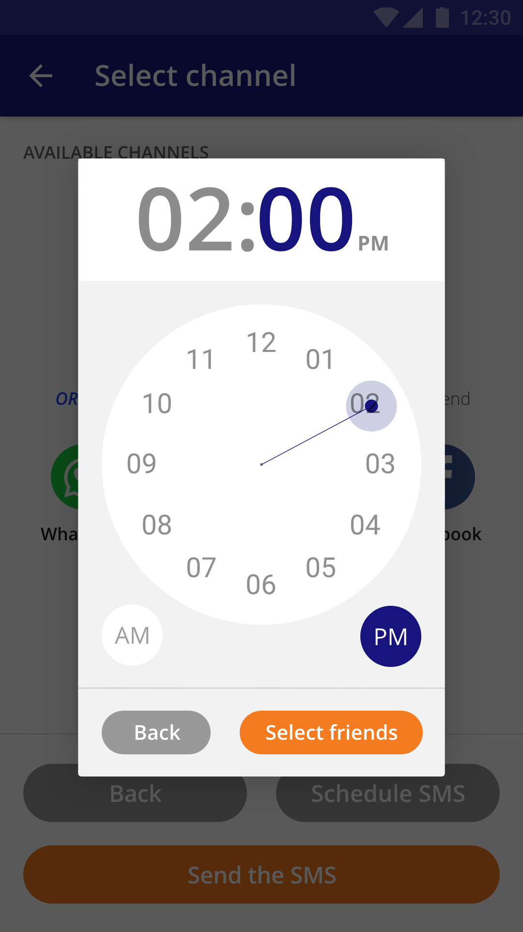
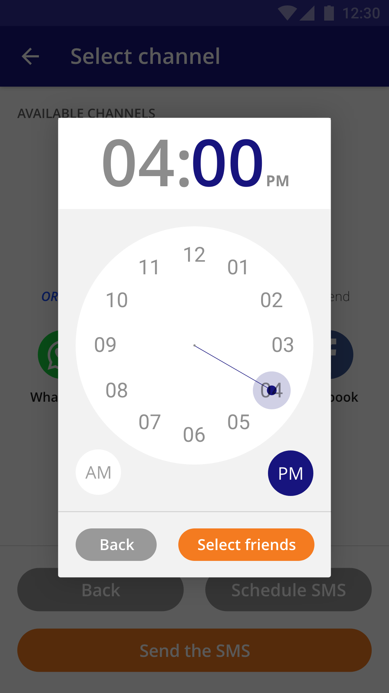
Scheduling SMS
Selecting the Time
By default the current time will be selected which the user can change if he/she wishes to. These screens represent that selection. From here the user can proceed to select friends/referrals.

Slide 19
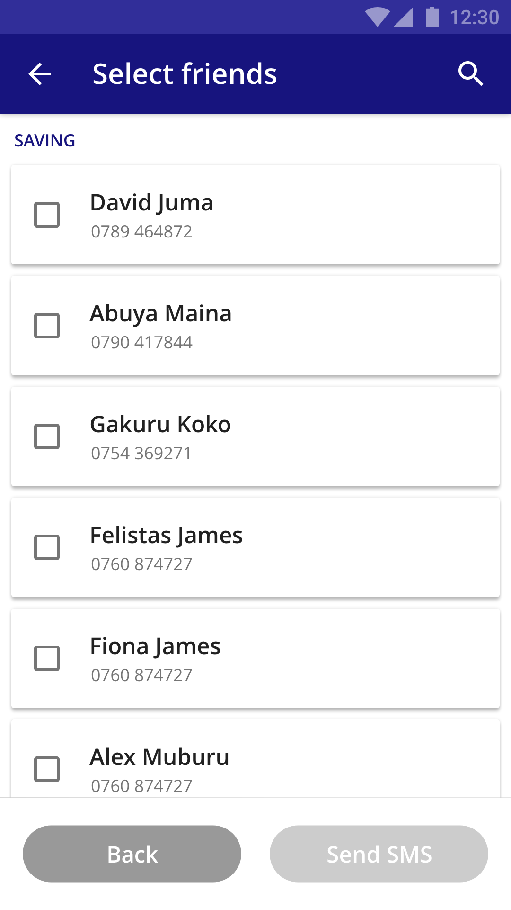
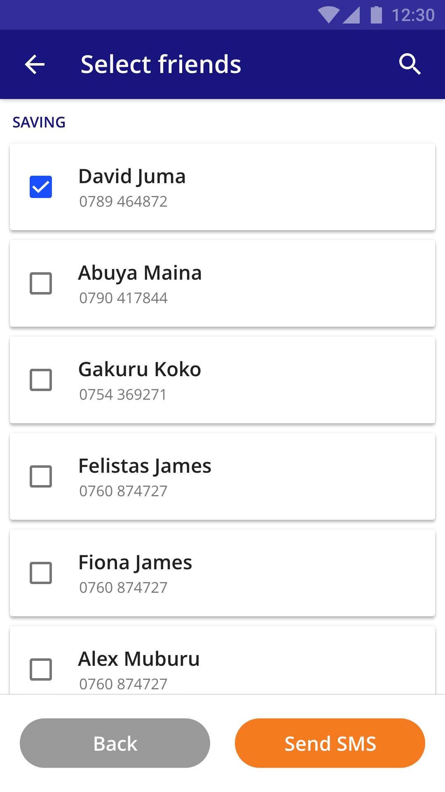
Selecting friends
Selecting friends from the referral list
From here user can select a friend or multiple friends. This list is categorised under ‘Saving’, ‘Paid’ and ‘Collected’. So that user knows who he/she need to send the message that they have selected on the ‘Select a message’ screen.

Slide 20
Thank you!

